Slide 1
CHAPTER 9
DDA And Bresenham's Algorithms

Slide 2
INTRODUCTION
DDA (Digital Differential Analyzer) algorithm and Bresenham's algorithm are methods for line drawing in computer graphics. DDA calculates intermediate points using slope, susceptible to rounding errors.
Bresenham's algorithm offers efficiency and accuracy by incrementally plotting points based on line slope and error calculation, preferred for integer coordinates. Both widely used in computer graphics, Bresenham's algorithm excels in speed and precision compared to DDA.

Slide 3
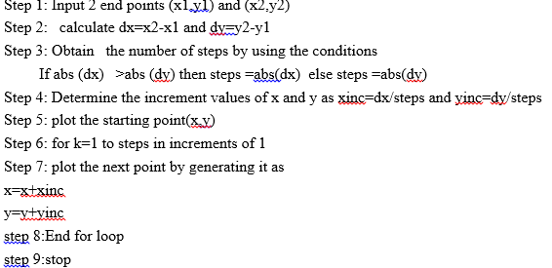
DDA Algorithm

Slide 4
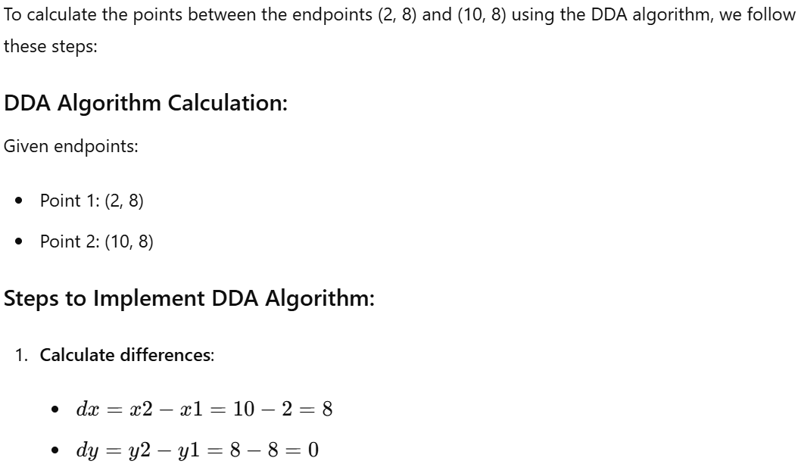
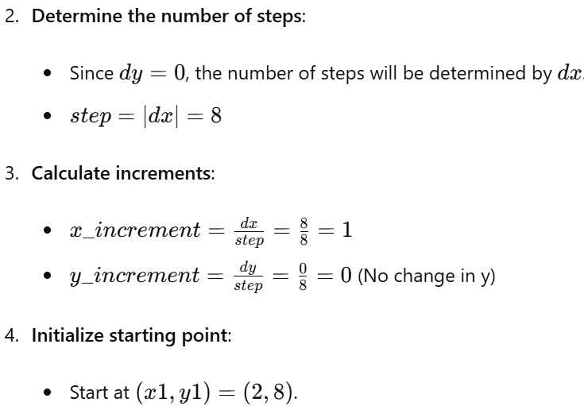
EXAMPLE

Slide 5
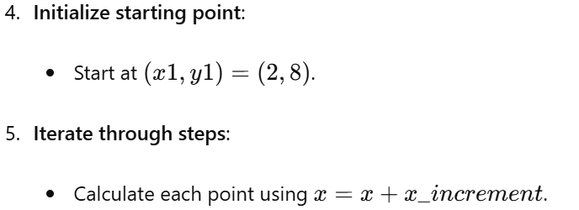
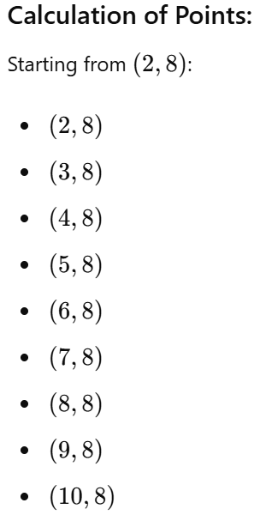
DDA…

Slide 6
Class work
Apply DDA algorithms, to determine all points on the line given two end points A (3,6) and B (7, 5). Plot the line in Cartesian plane

Slide 7
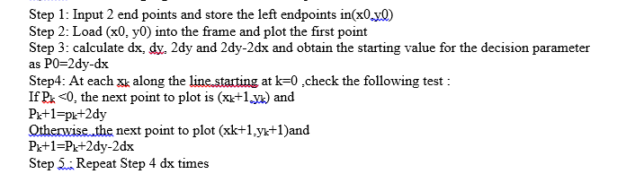
Bresenham’s algorithm

Slide 8
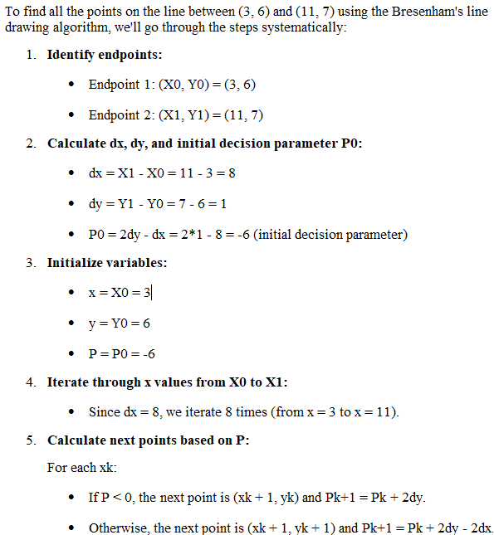
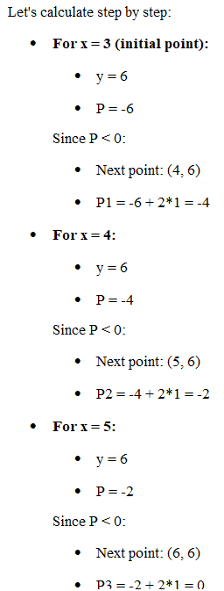
Explanations

Slide 9
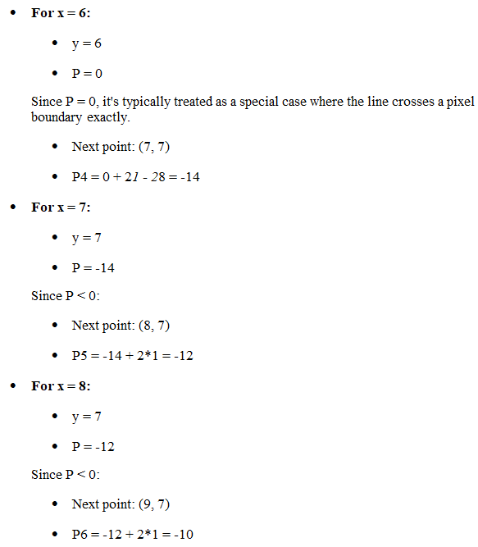
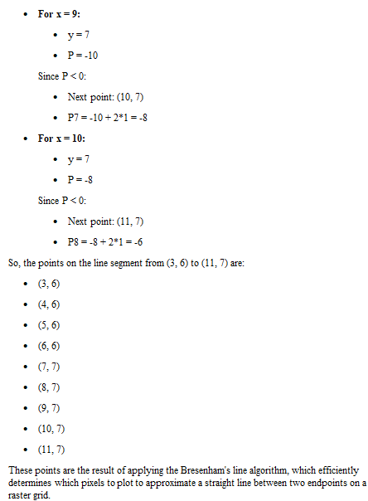

Slide 10
Banker’s Algorithm
Banker's algorithm is used in operating systems to ensure that the system does not enter an unsafe state where processes may deadlock due to conflicting resource requests. It's primarily used in systems where multiple processes are competing for a finite number of resources..

Slide 11
Why Banker’s algorithm is named so?
Banker’s algorithm is named so because it is used in banking system to check whether loan can be sanctioned to a person or not. Suppose there are n number of account holders in a bank and the total sum of their money is S.
If a person applies for a loan then the bank first subtracts the loan amount from the total money that bank has and if the remaining amount is greater than S then only the loan is sanctioned. It is done because if all the account holders comes to withdraw their money then the bank can easily do it.
In other words, the bank would never allocate its money in such a way that it can no longer satisfy the needs of all its customers. The bank would try to be in safe state always.

Slide 12
Data Structures used to implement the Banker’s Algorithm
There are four types of data structures used to implement Banker’s algorithm:
Available
Max
Allocation
Need

Slide 13
Available:
This data structure represents the number of available instances of each resource in the system at a given point in time.
Example: If there are 3 instances of Resource A, 2 instances of Resource B, and 5 instances of Resource C available, the Available vector might be represented as [3, 2, 5].

Slide 14
Max:
The Max matrix specifies the maximum number of instances of each resource that a process may need during its execution.
Example: If Process P1 can request up to 2 instances of Resource A, 1 instance of Resource B, and 3 instances of Resource C at maximum, the Max matrix entry for P1 might be [2, 1, 3].

Slide 15
Allocation:
The Allocation matrix indicates the current number of instances of each resource allocated to each process.
Example: If Process P1 currently holds 1 instance of Resource A, 0 instances of Resource B, and 2 instances of Resource C, the Allocation matrix entry for P1 might be [1, 0, 2].

Slide 16
Need:
The Need matrix specifies how many more instances of each resource a process needs to complete its execution.
Example: If Process P1 needs 1 more instance of Resource A, 1 more instance of Resource B, and 1 more instance of Resource C to complete its task, the Need matrix entry for P1 might be [1, 1, 1].

Slide 17
Relationship Between Data Structures:
Available is a vector that changes dynamically as resources are allocated and released.
Max and Allocation are typically static for each process once defined, while Need is computed dynamically based on Max and Allocation.

Slide 18
Usage in Banker's Algorithm:
Banker's algorithm uses these data structures to determine if granting a resource request will leave the system in a safe state (i.e., no deadlock). It checks if the requested resources can be allocated without exhausting the system's available resources or causing other processes to be unable to complete due to lack of necessary resources.
Processes must wait until their resource requests can be safely satisfied without violating the safety criteria, which involves checking the Available resources against the Need of the process requesting resources.
These data structures collectively help ensure efficient and deadlock-free resource allocation in systems employing the Banker's algorithm.

Slide 19
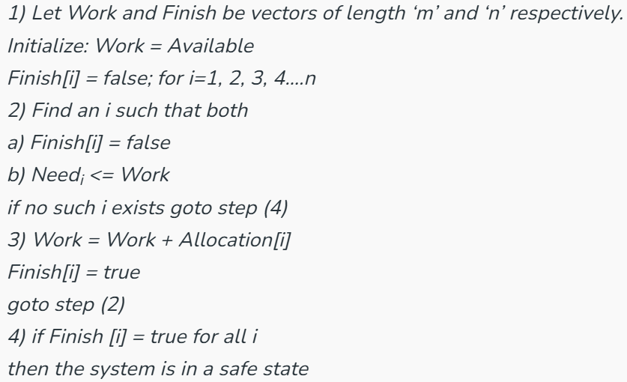
Safety Algorithm
The algorithm for finding out whether or not a system is in a safe state can be described as follows:

Slide 20
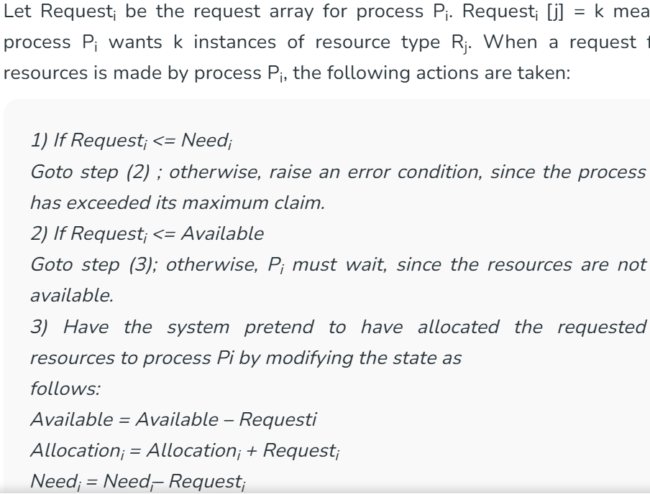
Resource-Request Algorithm

Slide 21
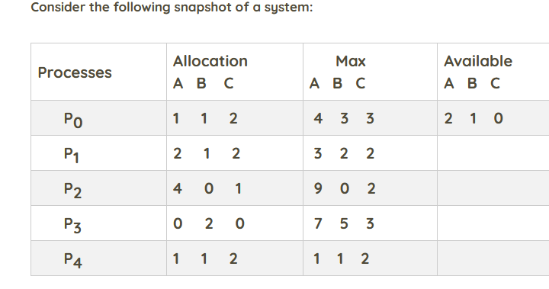

Slide 22
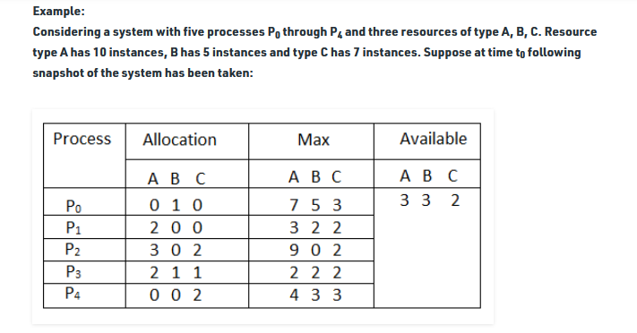
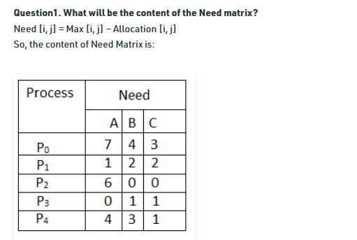

Slide 23
What is the safe sequence in OS?
A safe sequence is an order of processes where each process can complete its task without causing a deadlock. It ensures that every process gets the resources it needs without running out, so they all finish their jobs smoothly.

Slide 24
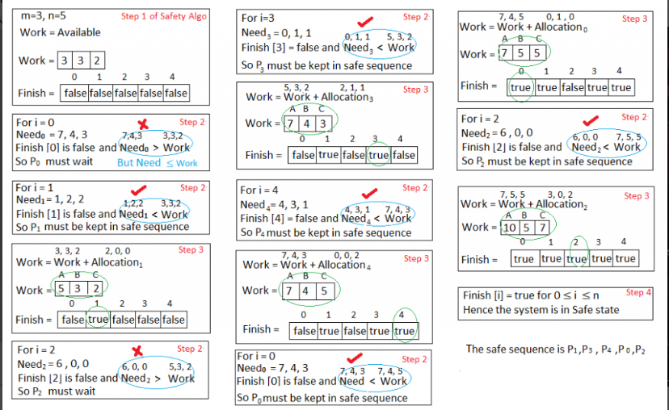
Is the system in a safe state? If Yes, then what is the safe sequence? Applying the Safety algorithm on the given system,

Slide 25
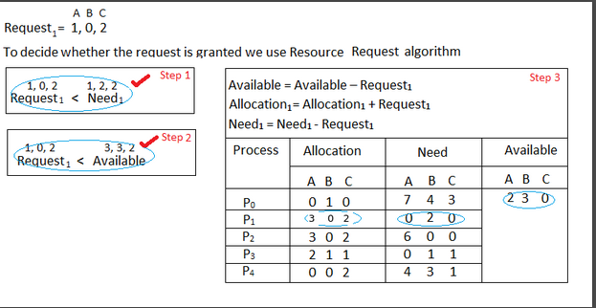
What will happen if process P₁ requests one additional instance of resource type A and two instances of resource type C?

Slide 26

We must determine whether this new system state is safe. To do so, we again execute Safety algorithm on the above data structures.

Slide 27
END

